Slide 1

SAP Analytics cloud training
Anubhav Oberoy
Day 5

Slide 2
Agenda – Day 5
Advance BI Scenario
- Variance Concept
- Smart Assist Scenario
- Augmented Analytics
- Smart Predict Forecast
- Smart Insight
- Smart Discovery
- Smart Grouping
- Roadmap and Support
---Break---
Introduction to Planning
- What is Planning
- Evolution of Planning
- Collaborative Planning
- SAC Supports Planning options
- Planning Jargons
- Introduction to Planning models
Notes:
Working with Planning Models
- Create Demo Scenario
- Create Planning Model
- Version Management
- Create Simple Balance Sheet
- What if Analysis
- Update Scenario

Slide 3









Slide 4









Smart Assist Portfolio of SAC
Search to Insight
Smart Insights
R Visualizations
Smart Transformation
Time Series Forecasting
Smart Discovery
Smart Grouping
Deliver Simplicity through Machine Learning
Integrate machine learning seamlessly into business processes and workflows
Leverage machine learning to save time, remove complexity, and gain actionable insights
www.anubhavtrainings.com

Slide 5
Smart Assist
Search to Insight – Augmented Analytics
Allows users to use NLP (Natural Language) to command system and system can convert NL using NLP capability of machine learning and present the outputs to the user.
2. Smart Discovery
It offers a complete machine learning suite(robot) to build ENTIRE dashboard automatically with just one click, what we need to specify is the measure which we want to use to be in focus. It will also find the anomalies and unexpected hidden patterns in the data.
3. Smart Insight
Its simple, easy to use machine learning to find out most important key influencers contributing to a measure. We will also be able to drill down to these influencers.
www.anubhavtrainings.com

Slide 6
Smart Assist
4. Time Series Forecasting
Depending on past data of a measure based on time (dimension) we can find the expected value of a measure w.r.t time and deviation. SAC usage 2 in-built algorithms to predict forecast
Triple Smoothing
Linear Forecast
5. Smart Grouping
Allows us to CLUSTER data depending in groups we choose, suppose we want to segmentize the data points in multiple groups. E.g. group customers based on their ability to pay the pending bills, group students of a class in merit, demerit and mediocre.
www.anubhavtrainings.com

Slide 7
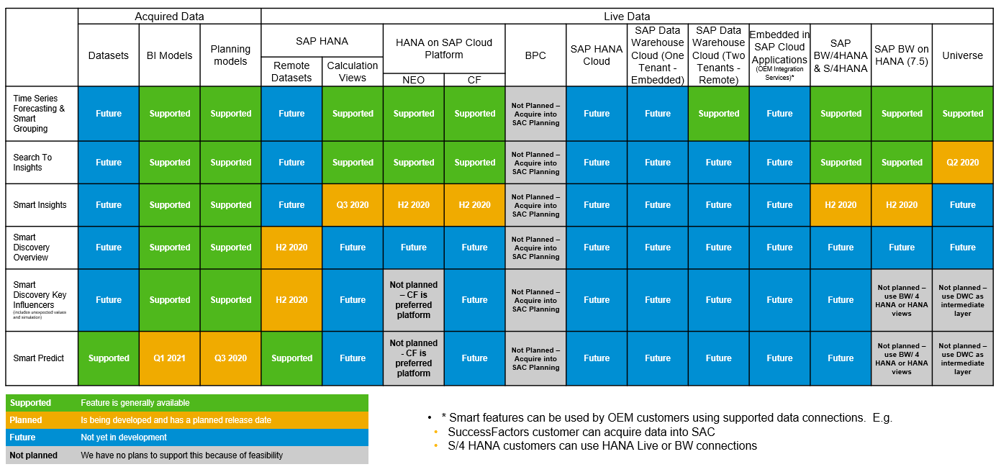
Smart Feature Support Matrix
www.anubhavtrainings.com

Slide 8
What is planning
Planning is a fundamental management function, which involves deciding before head,
what to be done,
when it will be done,
how it will be done and
who is going to do it.
It is an intellectual process which lays down an organization objectives to be able to achieve those goals. It chalks out specifically how to attain a specific goal. For example: how many new resources I need to hire in the same's department to touch 1bn sales.
Planning is performed for various functions of a company, such as sales planning, expense planning, core financial planning, reporting FY numbers through reports to shareholders of the company. HR plans for the people at all suggested levels (VP, SVP, Managers). Planning helps to increase coordination and onerous tasks that are distributed across multiple departments.
www.anubhavtrainings.com

Slide 9

Planning Evolution with SAC
PAST
NOW
NEXT
Centralized process to connect strategy to financial goals
SAP (BPC) dominated the “Corporate Core”
Decentralized owned by the business
business buyer take over buying decision
Connect all LOBs across the enterprise
SAC embedded in Enterprise Intelligent Suite
www.anubhavtrainings.com

Slide 10
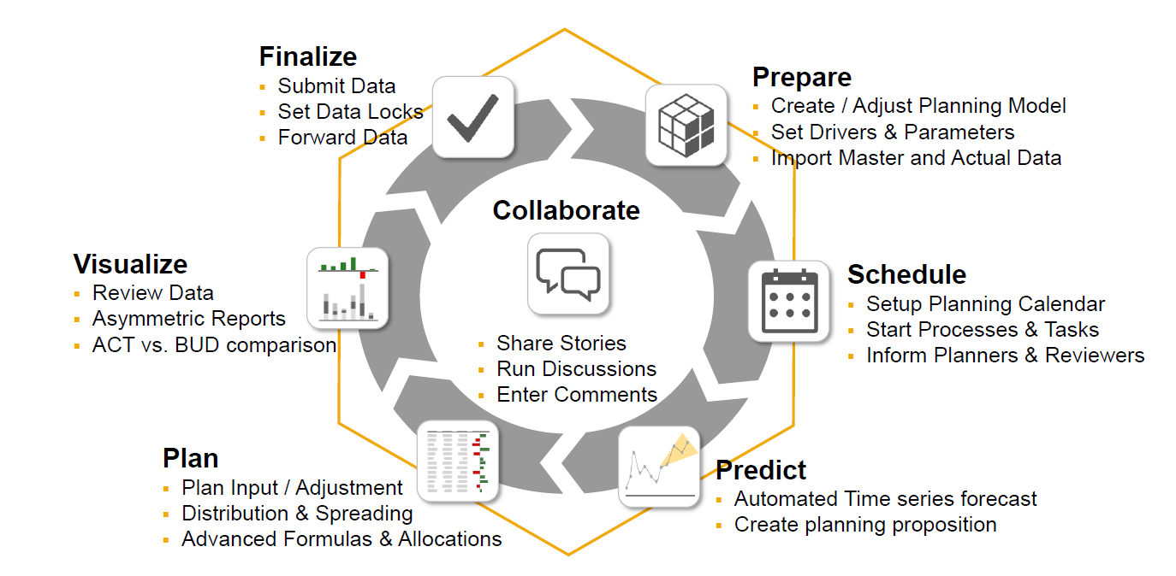
What is collaborative planning
www.anubhavtrainings.com

Slide 11
What are all we do in SAC
Modeling
What-if and Visualization
Allocation
Predictive Forecast
Value Driver Trees
Collaboration
Collect data
Model Dimensions
Currency conversion rates
Create planning model
Set the rates
Define account dimension (business account)
Version management
Direct Entry
Distribution/spreading
Variance chart
Copy/paste data
Introduce new entity
Thresholds
Asymmetric reports
Formulas
Forecast
www.anubhavtrainings.com

Slide 12
End of Day 5

Slide 13

Questions

Slide 14

Anurag Bajaj
anurag.bajaj02@gmail.com

